Slide 2
„ I ha HA „ / 2009/ litography and stencil / 100 x 70 cm

Slide 3
„ From wich willage You are „ / 2010 / litography and stencil / 100 x 70 cm

Slide 4
„ Sailiors Krasnajaflota „ / 2010 / litography and stencil / 100 x 70 cm

Slide 5
„ Tower„ / 2010 / litography and stencil / 100 x 70 cm

Slide 6
„ It’s not us, it’s not here„ / 2011 / litography and stencil / 300 x 210 cm

Slide 7
„ Tonietuziom „ / 2011 / litography and stencil / 100 x 70 cm

Slide 8
„ Dingi Salmon„ / 2011 / litography and stencil / 100 x 70 cm

Slide 9
„ Red t - shirt„ / 2011 / litography and stencil / 100 x 70 cm

Slide 10
„ Jump by the fence with make up and 3 drums„ / 2011 / litography stencil / 100 x 70 cm

Slide 11
„Antwortowcy „ / 2010 / litography and stencil / 100 x 70 cm

Slide 12
„ My eastern bizons„ / 2011 / litography and stencil / 100 x 70 cm

Slide 13
„ Searching „ / 2013 / linocut and stencil / 100 x 70 cm

Slide 14
„I don’ know who I ‘m „ / 2013 / litography and stencil / 100 x 70 cm

Slide 15
„Antwortowcy „ / 2010 / mix technique / 100 x 70 cm

Slide 16
„Gold one „ / 2010 / anastatic print , stencil/ 100 x 70 cm

Slide 17
„Black lady „ / 2014 / anastatic print , stencil/ 100 x 70 cm

Slide 18
„yhm…. Why not? „ / 2014 / litography, stencil/ 100 x 70 cm

Slide 19
„Freaks on the street„ / 2015 / litography and stencil / 60 x 80 cm

Slide 20
„Was happening „ / 2015 / litography and stencil / 600 x 70 cm

Slide 21
„Was happening „( detail) / 2015 / litography and stencil /

Slide 22
„Was happening „( detail) / 2015 / litography and stencil /

Slide 23
„Be like that, don’t be like that„ / 2015 / anastatic print , stencil/ 100 x 70 cm

Slide 24
„Two freaks in one„ / 2016 / mix technique / 100 x 70 cm

Slide 25
„ Yawning „ / 2017 / mix technique / 74 x 69 cm

Slide 26
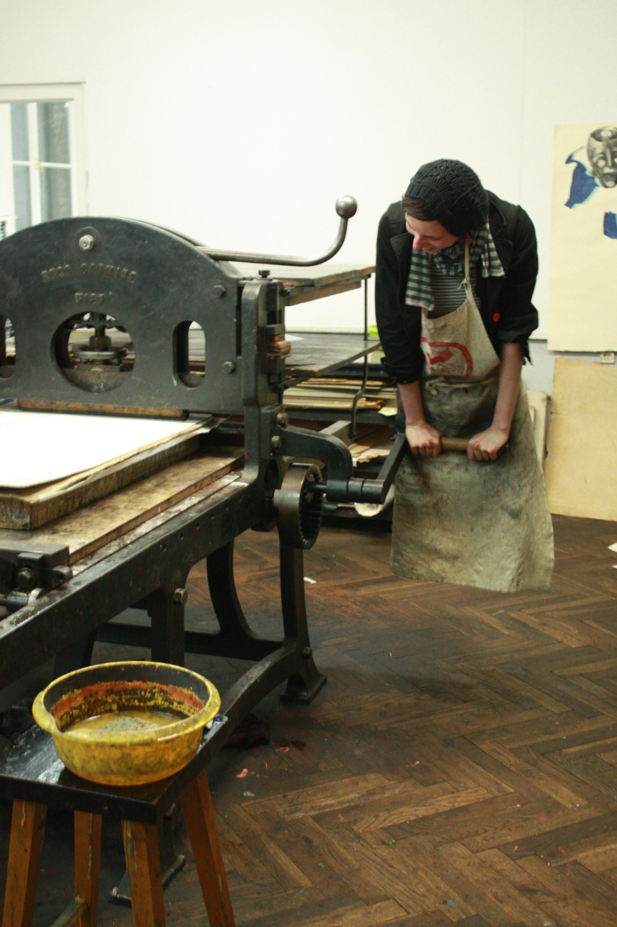
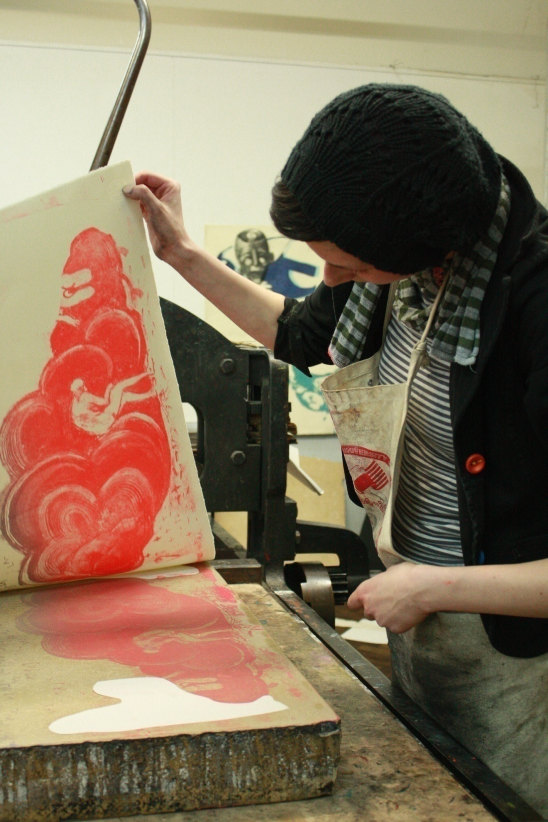

Slide 27
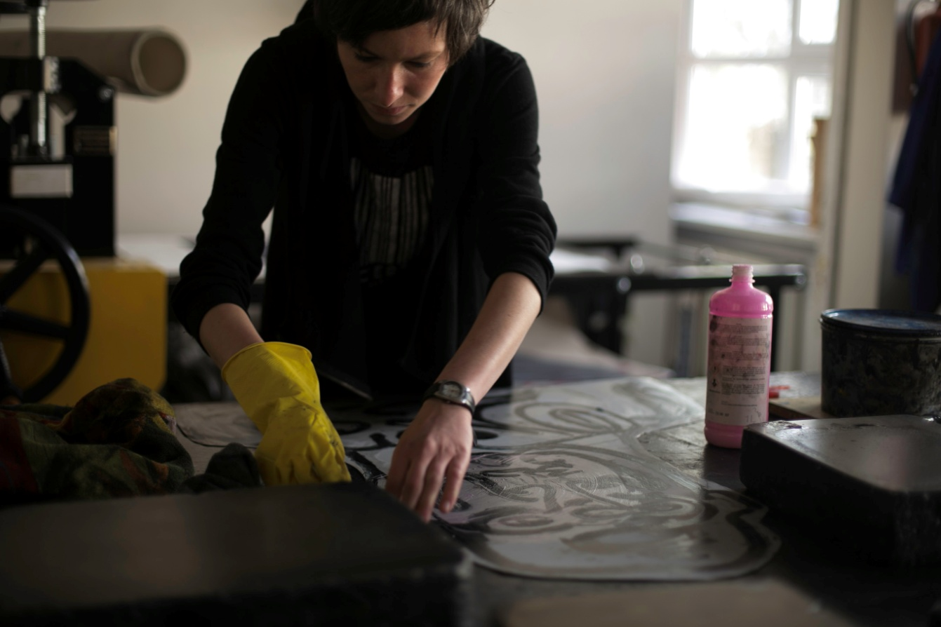
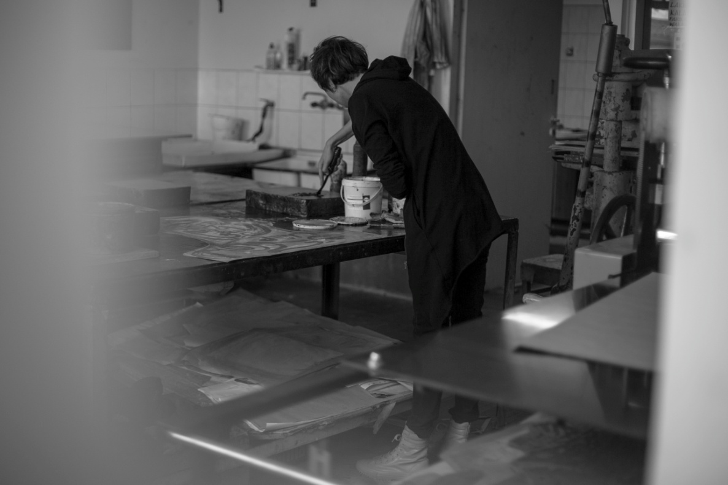

Slide 28
